Slide 1
STORYTELLING WITH DATA

Slide 2
The (Messy) Analysis Process
Objective/
Rationale
Utilization and Decision Support
Data Collection
Data Exploration
Infrastructure and Data Management
Data Preparation
Modeling and Analysis
Communication

Slide 3
WHO IS THE AUDIENCE?
Avoid general audiences: address Lines of Business (finance, engineering, HR, etc.)
Identify decision-makers and the various audience roles
Ask the following questions:
what relationship do you have with them?
how do they perceive you?
how do you establish trust and credibility?

Slide 4
WHAT DO THEY NEED TO DO?
Ask for action:
what decisions are people going to make from the analysis?
how often are they going to be looking at the data?
how often do they expect the data to be refreshed?

Slide 5
WHAT DO YOU NEED TO KNOW?
What data is actually available?
is the data clean?
can it be accessed?
is it being “massaged”, used to paint a rosy picture?

Slide 6
WHAT DO YOU NEED TO KNOW?
How much will the audience need/want to interact with the charts?
are they passive?
can they run limited filtering?
what data can they download (if any)?

Slide 7

During WWII, mathematician A. Wald undertook a study to help protect British bombers flying over enemy territory.
Data included: the number and location of bullet holes on returning aircraft, and the goal was to use this information to determine where to add armor to best protect the plane’s structure.
A chart was created to show where the maximum number of bullet holes were located on returning aircraft. This chart showed greatest damage on the aircraft extremities, not on the main wing and tail spars, engines, and core fuselage areas.

Slide 8
WALD’s STORY
As such, the Air Ministry wanted to add armor to the extremities. Wald suggested they were dead wrong.
To avoid “survivorship bias”, armor should be added to the areas with the fewest holes: if no returning planes had holes in their wing spars and engines, then even a few holes in those locations were deadly.
Take-Away: the data that is missing may be as important to story than the data that is there. Storytelling is not always an obvious endeavour.

Slide 9
Creating A NARRATIVE
There are a number of ways of constructing a narrative, including:
chronological
most important first, or least important first
begin with the end
success first, bad news last, or bad new first, success last
Advice: tell the story of the data in a number of different ways
Some dashboards are temporary but some will be a constant reference: this has an impact on how the data should be presented.

Slide 10
MAINTAINING A CLEAR NARRATIVE
Horizontal logic (epic):
if your visualizations span many pages then the title of each page should tell you the story
reinforce with an executive summary dashboard or report at the beginning
Vertical logic (anthology):
one page or many, the content should reinforce the title and vice versa (self-reinforcement)
there should be a logical link between all the elements, tags and visual aids on the page

Slide 11
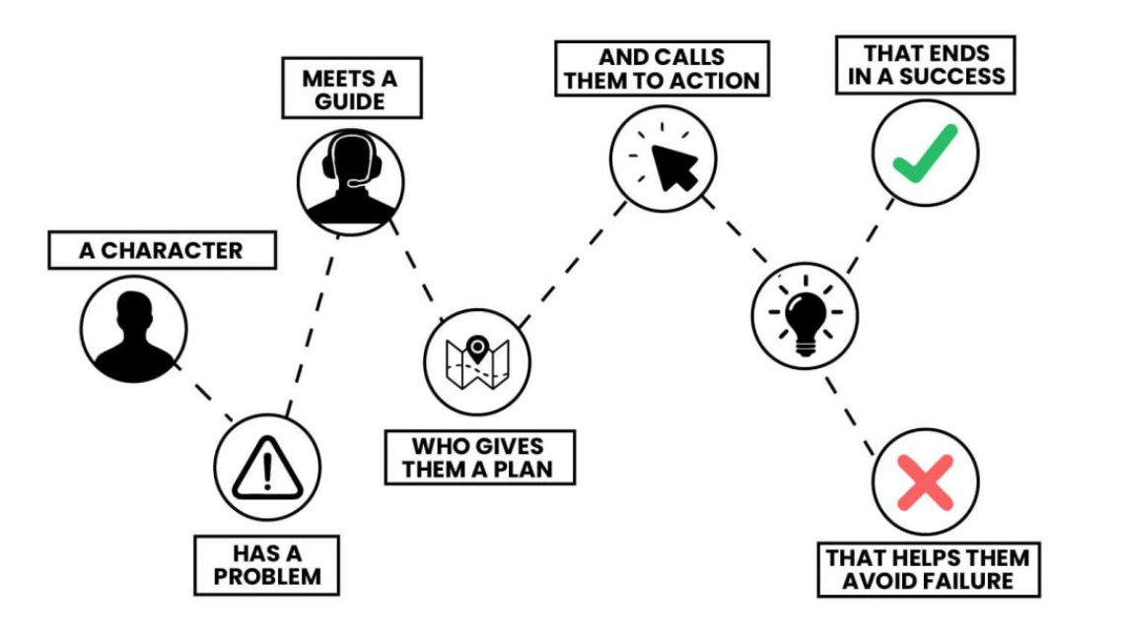
STORY TELLING: STORYBRAND FRAMEWORK

Slide 12
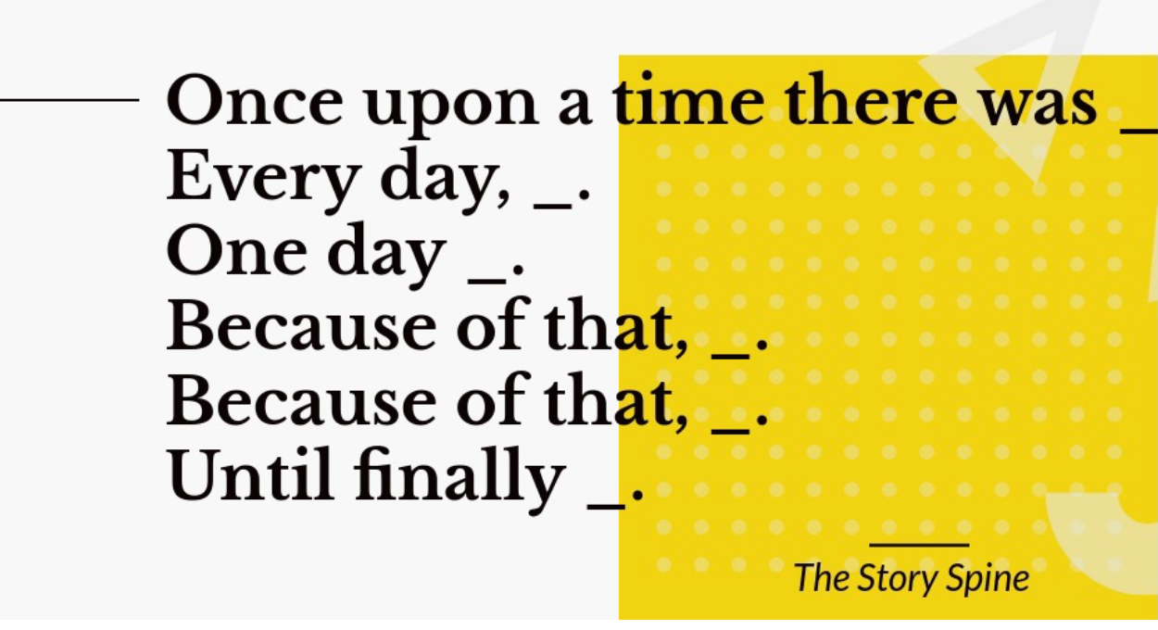
SPINE OF A STORY: PIXAR

Slide 13
TYPES OF MEMORIES
Telling stories engages our memory:
iconic memory – directs the eye
short-term memory – limits how many charts are found in dashboards
long-term memory – helps the audience remember what they saw

Slide 14
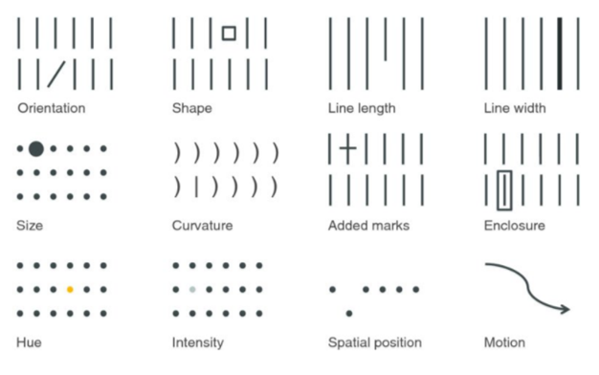
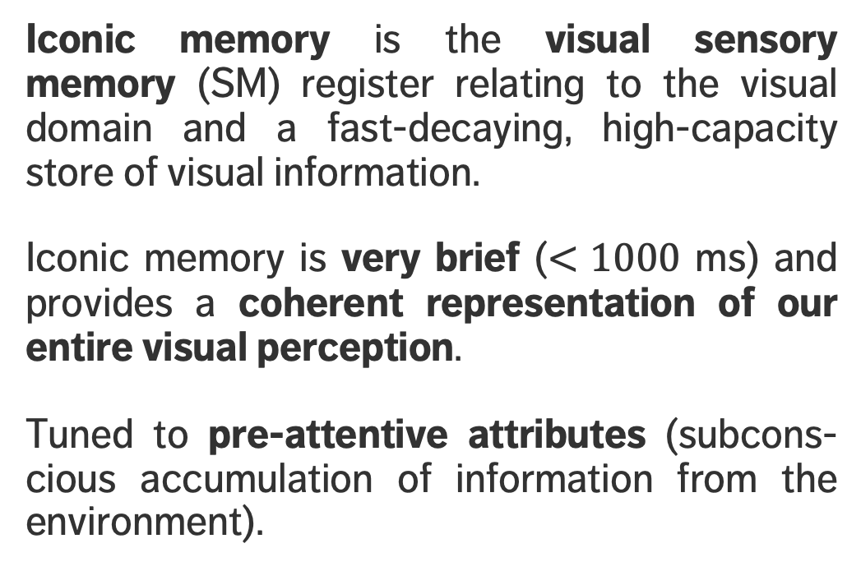
ICONIC MEMORY
Iconic memory is the visual sensory memory (SM) register relating to the visual domain and a fast-decaying, high-capacity store of visual information.
Iconic memory is very brief ($<1000$ ms) and provides a coherent representation of our entire visual perception.
Tuned to pre-attentive attributes (subcons-cious accumulation of information from the environment).

Slide 15
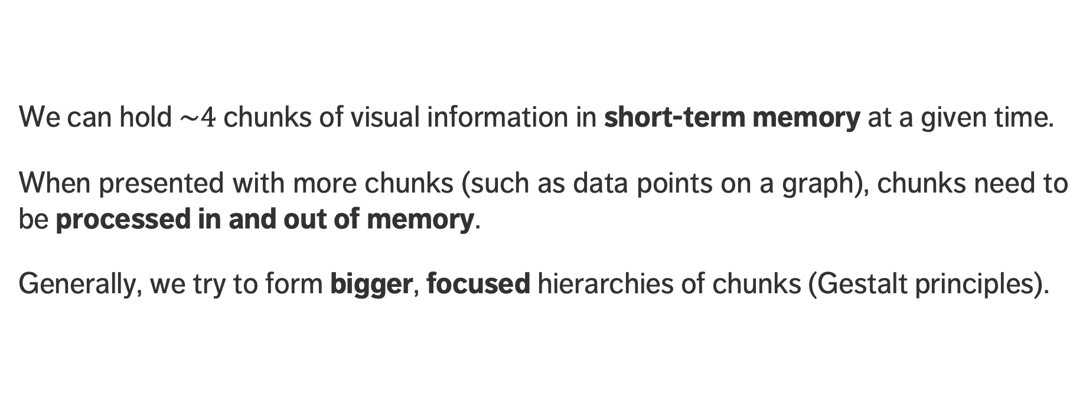
SHORT-TERM MEMORY
We can hold $\sim 4$ chunks of visual information in short-term memory at a given time.
When presented with more chunks (such as data points on a graph), chunks need to be processed in and out of memory.
Generally, we try to form bigger, focused hierarchies of chunks (Gestalt principles).

Slide 16
LONG-TERM MEMORY
Long-term memory is built up over a lifetime and is the basis for pattern recognition and general cognitive processing.
It is an aggregate of visual memory and verbal memory.
Images help us recall long-term memory, making the story “stick”.
Context-providing text also makes a difference:
You have currently selected 28,711 ATIP requests totaling 6,597,612 pages of information
VS

Slide 17
LONG-TERM MEMORY
Long-term memory is built up over a lifetime and is the basis for pattern recognition and general cognitive processing.
It is an aggregate of visual memory and verbal memory.
Images help us recall long-term memory, making the story “stick”.
Context-providing text also makes a difference:
30K
requests
6.6M
pages
230
pages/request
VS

Slide 18
STORYBOARDING
Storyboarding is a way to summarize the flow of information into a coherent whole.
It helps us determine how many pages/elements per page we might need.
This is NOT the same as designing the layout of a dashboard.
Storyboarding is used to define the story and the dashboard’s content.

Slide 19
Storyboarding – Example
1. State intended hiring goal for the year
2. Describe what is driving the hiring (Fed Gov’t Init)
3. Show how close/far the goal is as of today
4. Show which departments have the highest requirements
5. Demonstrate which groups are impacted the most
6. Ask/tell the reader how they can help

Slide 20
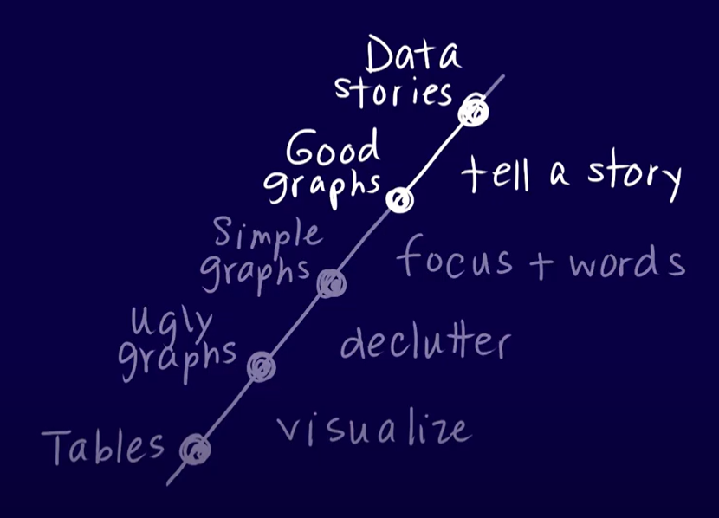
Evolving a Visualization
Source: Storytelling with Data

Slide 21
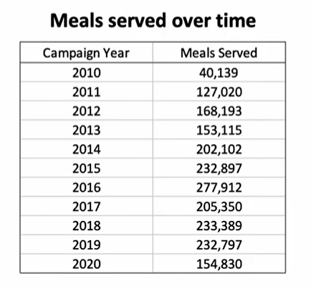
Evolving a Visualization
Source: Storytelling with Data
Source: Storytelling with Data

Slide 22
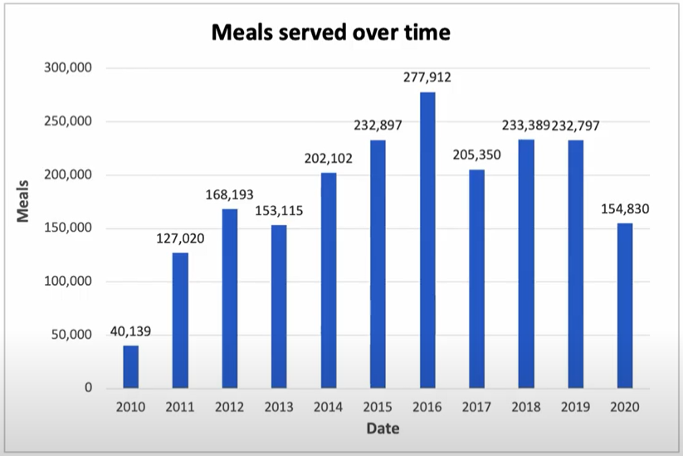
Evolving a Visualization
Source: Storytelling with Data
Source: Storytelling with Data

Slide 23
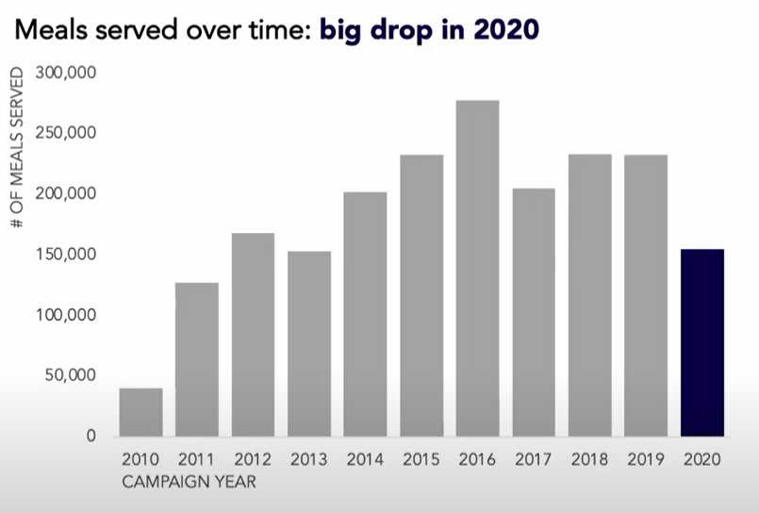
Evolving a Visualization
Source: Storytelling with Data
Source: Storytelling with Data

Slide 24
EXERCISE
Individually or in teams, prepare a storyboard for the dashboard you designed in the previous section.

Slide 25
FUNDAMENTAL PRINCIPLES OF DATA VIZ

Slide 26
Fundamental Principles OF ANALYTICAL DESIGN
[E. Tufte, Beautiful Evidence]
Symmetry to visual displays of evidence: consumers should be seeking exactly what producers should be providing, namely
meaningful comparisons
propose causal networks and underlying structure
multivariate links
integrated and relevant data
honest documentation
primary focus on content

Slide 27
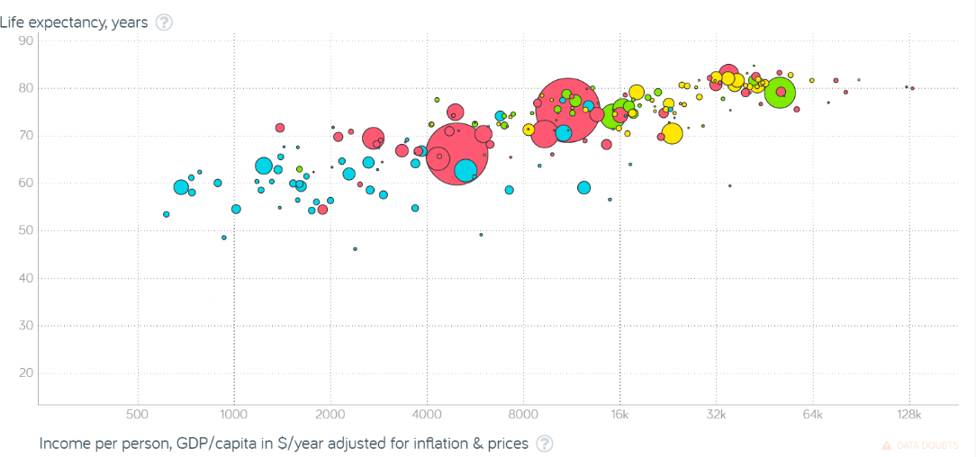
[Gapminder Foundation]
Non-Integrated Data

Slide 28
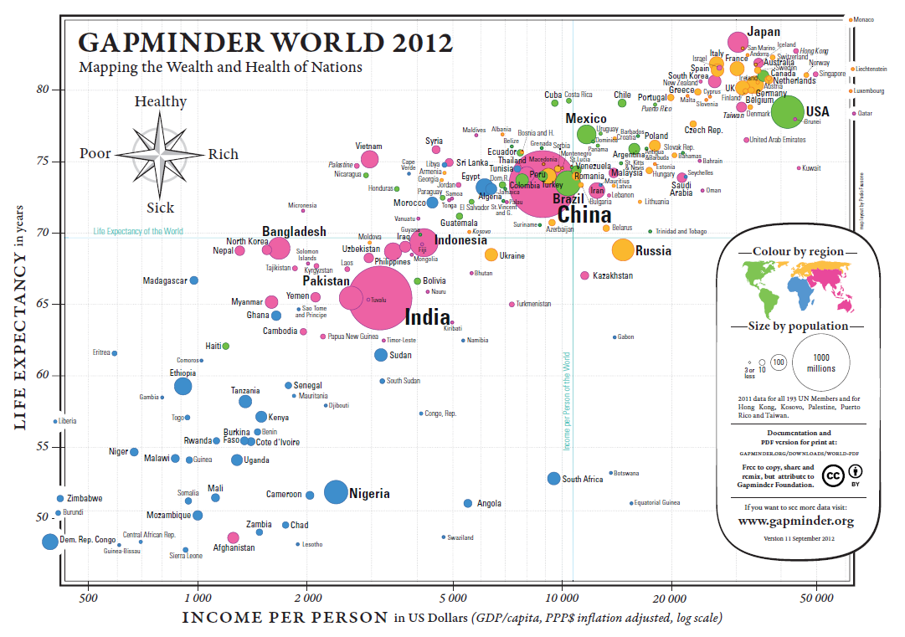
[Gapminder Foundation, https://www.ted.com/talks/hans_rosling_shows_the_best_stats_you_ve_ever_seen]

Slide 29
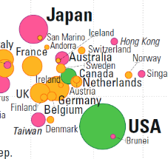
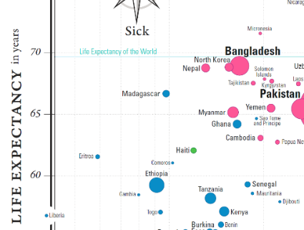
[Gapminder Foundation, https://www.ted.com/talks/hans_rosling_shows_the_best_stats_you_ve_ever_seen]
Meaningful Comparisons

Slide 30
[Gapminder Foundation, https://www.ted.com/talks/hans_rosling_shows_the_best_stats_you_ve_ever_seen]
Underlying Structure and Multivariate Links

Slide 31
[Gapminder Foundation, https://www.ted.com/talks/hans_rosling_shows_the_best_stats_you_ve_ever_seen]
Underlying Structure and Multivariate Links
Underlying Structure and Multivariate Links

Slide 32
[Gapminder Foundation, https://www.ted.com/talks/hans_rosling_shows_the_best_stats_you_ve_ever_seen]
Underlying Structure and Multivariate Links
Underlying Structure and Multivariate Links

Slide 33
[Gapminder Foundation, https://www.ted.com/talks/hans_rosling_shows_the_best_stats_you_ve_ever_seen]
Documentation

Slide 34
Presenting Analysis Results
Graphics should be clear and engaging.
Not every pretty picture tells a story, but if a story can't be told with pretty pictures, perhaps it’s time to re-think the story…
Graphical representation techniques appear regularly – it’s too early to tell which ones will stand the test of time.
Don’t be afraid to try something new if it helps convey the message.
Notes:
There is always a danger that if certain types of visualization techniques take over, the kinds of questions that are particularly well-suited to providing data for these techniques will come to dominate the landscape, which will then affect data collection techniques, data availability, future interest, and so forth.

Slide 35
DESIGN ELEMENTS
Is the point getting across? Integrated data helps convey the message.
Not all retinal variables are equally effective when it comes to convey or represent information. Experiment as needed to find the optimal choice for the given context.
Adding design elements can enhance our understanding of the data.
How we spot patterns affect what we get out of data presentations.
Data displays are not just about picking a random visualization method. The result varies depending on the structure of the data and the (combinations of) questions.

Slide 36
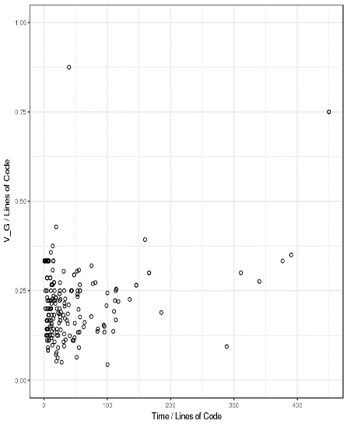
Representing Multivariate Observations
[http://promise.site.uottawa.ca/SERepository/datasets/cm1.arff]
2 variables can be represented by position in the plane. Additional factors can be depicted with:
size
color
value
texture
line orientation
shape
(motion?)
NASA CM1 Dataset (subset)

Slide 37
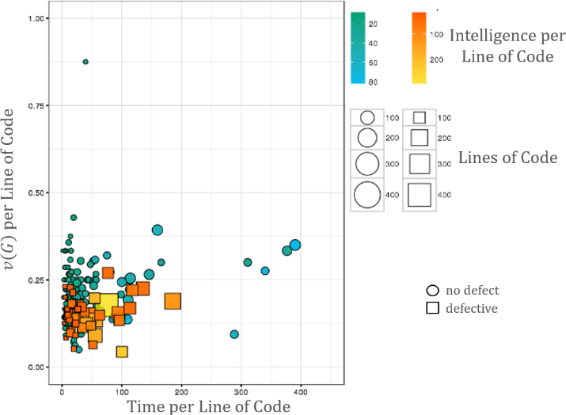
[http://promise.site.uottawa.ca/SERepository/datasets/cm1.arff]
NASA CM1 Dataset (subset)
colour
size
shape
position

Slide 38
DISCUSSION
What are some data visualization rules you have picked up over the years?
Are any of them hard rules?
Which of the rules/principles shown here seem more fundamental?

Slide 39
HALL-of-FAME / HALL-OF-SHAME

Slide 40
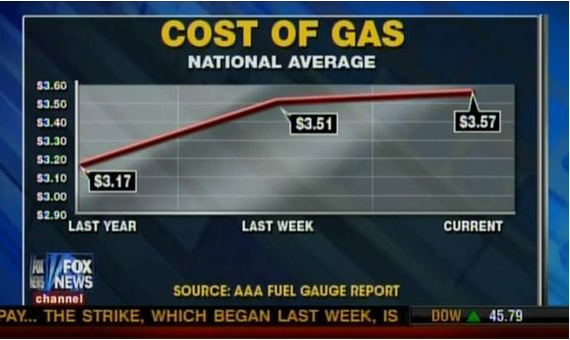
Misleading Charts
[Fox News, February 20, 2012, mediamatters.org, simplystatistics.org, badgraphs.tumblr.com]

Slide 41
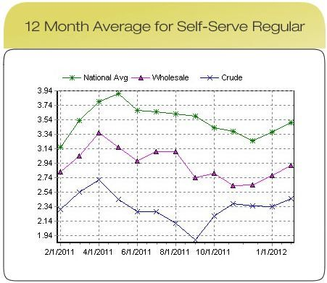
[AAA Gas Prices, found on mediamatters.org]

Slide 42
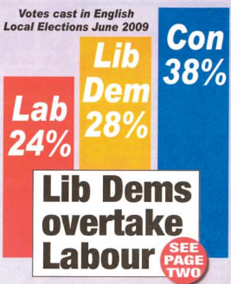
Misleading Charts
[Norwich North Electoral District, mediamatters.org, simplystatistics.org, badgraphs.tumblr.com]

Slide 43
Misleading Charts
Problems: disingenuous, selective and/or incompetent reporting
Solutions:
Consistent scales and units of comparison
Full time series
No cherry picking the data range
Cutting off -axis will exaggerate some effects
Numbers must add up

Slide 44
What to Watch For
Some methods yield visually striking, yet misleading, charts.
Be on the lookout for:
tampering with axes and linear scales
scaling effects, when representing data points as shapes or volumes
cherry-picking by omitting certain data points
For low-dimensional datasets, a tabular display may provide as much information and be less likely to mislead.

Slide 45
You BE The Judge
Some of the following are (arguably) good visualizations. But some are not!
Which are which? You be the judge…

Slide 46
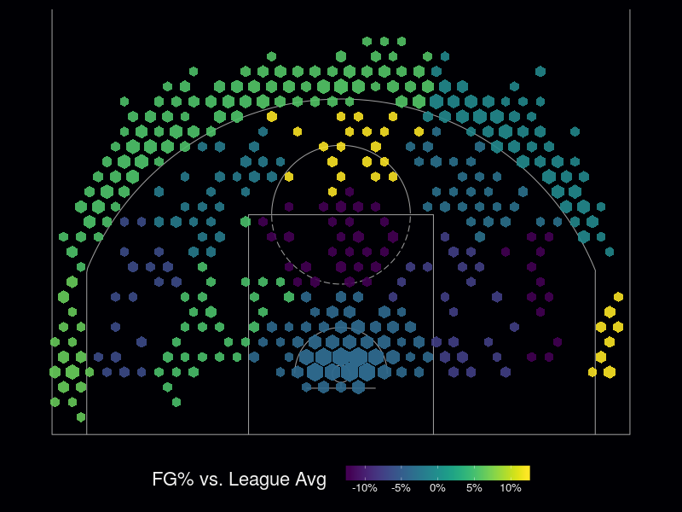
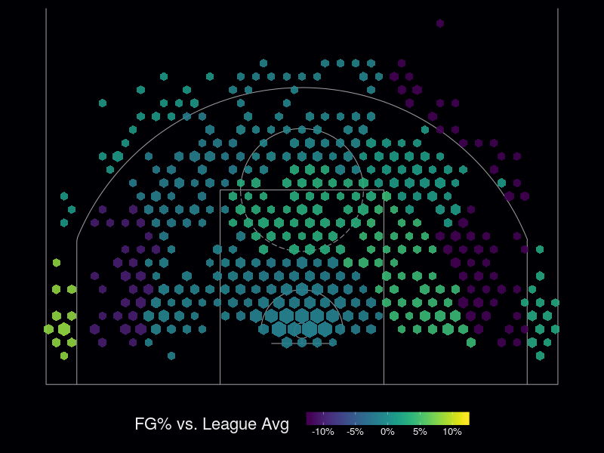
[T.W. Schneider]
NBA FG% Against League Average (‘15–’16)
Kyle Lowry
DeMar DeRozan
What comparisons can you make? Do you understand the encoding? The context?

Slide 47
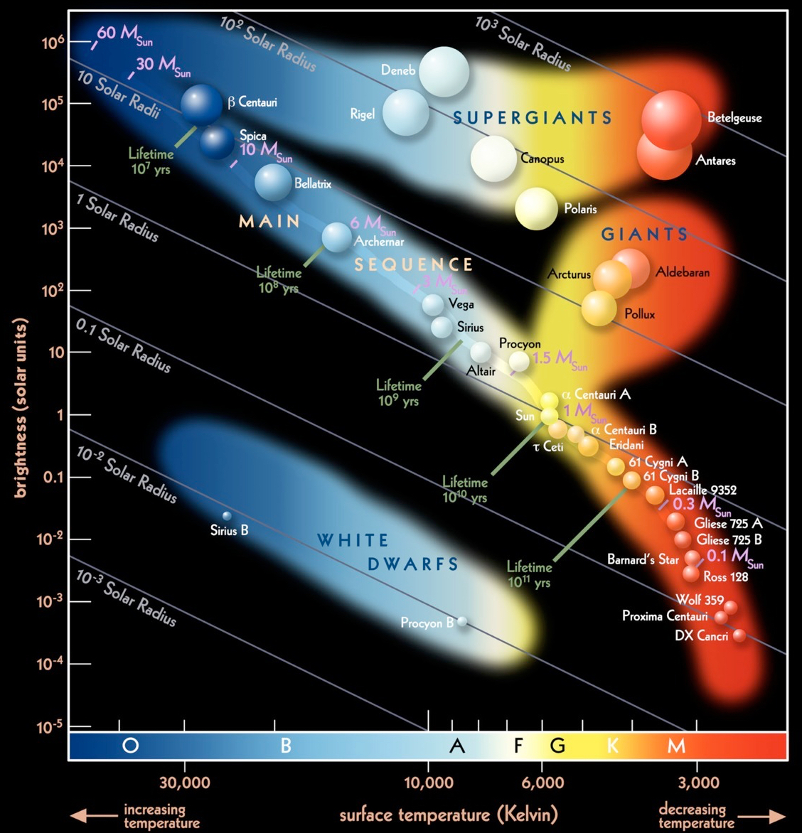
[European Southern Observatory]
Hertzprung-Russell Diagram
Data Elements
star radius (x 2)
surface temperature (x 2)
spectral class
brightness
mass
lifetime
name
Underlying Structure
4 clusters/group
lifetime, mass and radius are related to brightness and surface temperature on the Main Sequence
Only a subset of all the stars is shown in the HR diagram.

Slide 48
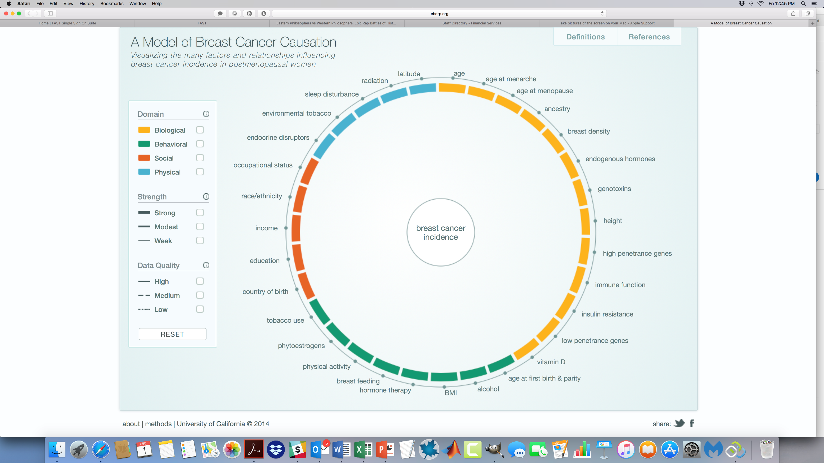
[http://www.cbcrp.org/causes]
A Model of Breast Cancer Causation
Can you infer causality from this diagram?
Notes:
A Model of Breast Cancer Causation, California Breast Cancer Research Programme, 2014

Slide 49
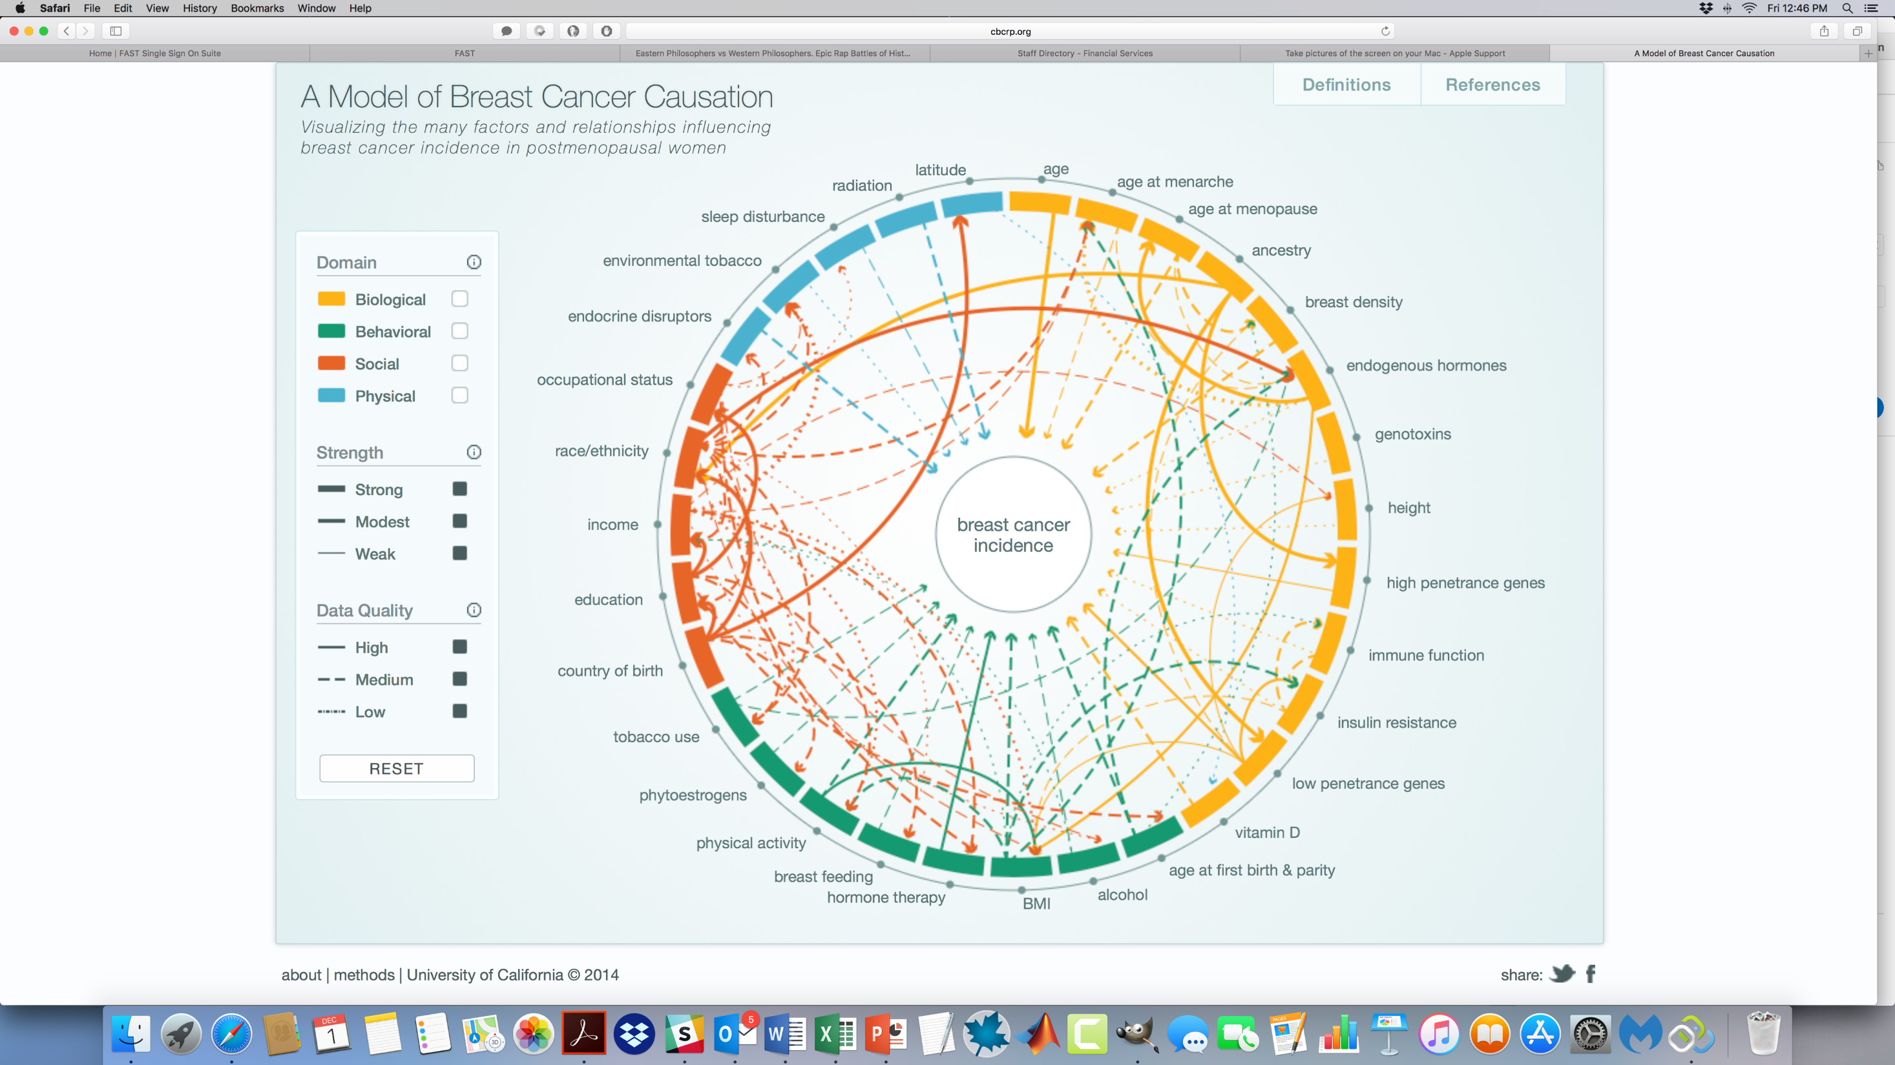
[http://www.cbcrp.org/causes]
A Model of Breast Cancer Causation
Can you infer causality from this diagram?
Notes:
A Model of Breast Cancer Causation, California Breast Cancer Research Programme, 2014

Slide 50
Lexical Distance Among the Languages of Europe
[T.Elms, Etymologikon]

Slide 51
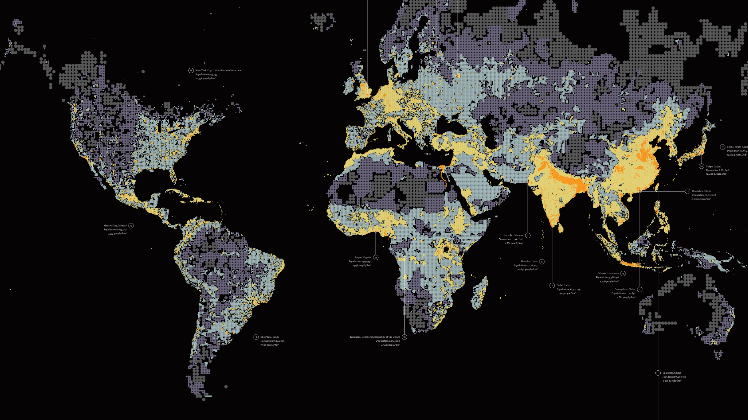
World’s Population “Dencity”
[Fathom]

Slide 52
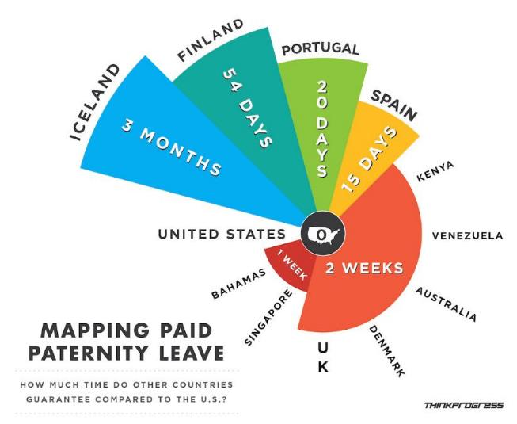
[https://thinkprogress.org, found on http://viz.wtf]

Slide 53
[https://thinkprogress.org, found on http://viz.wtf]
Low data density
High chartjunk ratio
Scaling effects
Cherry-picking
Why not use a bar chart or a tabular display instead?

Slide 54
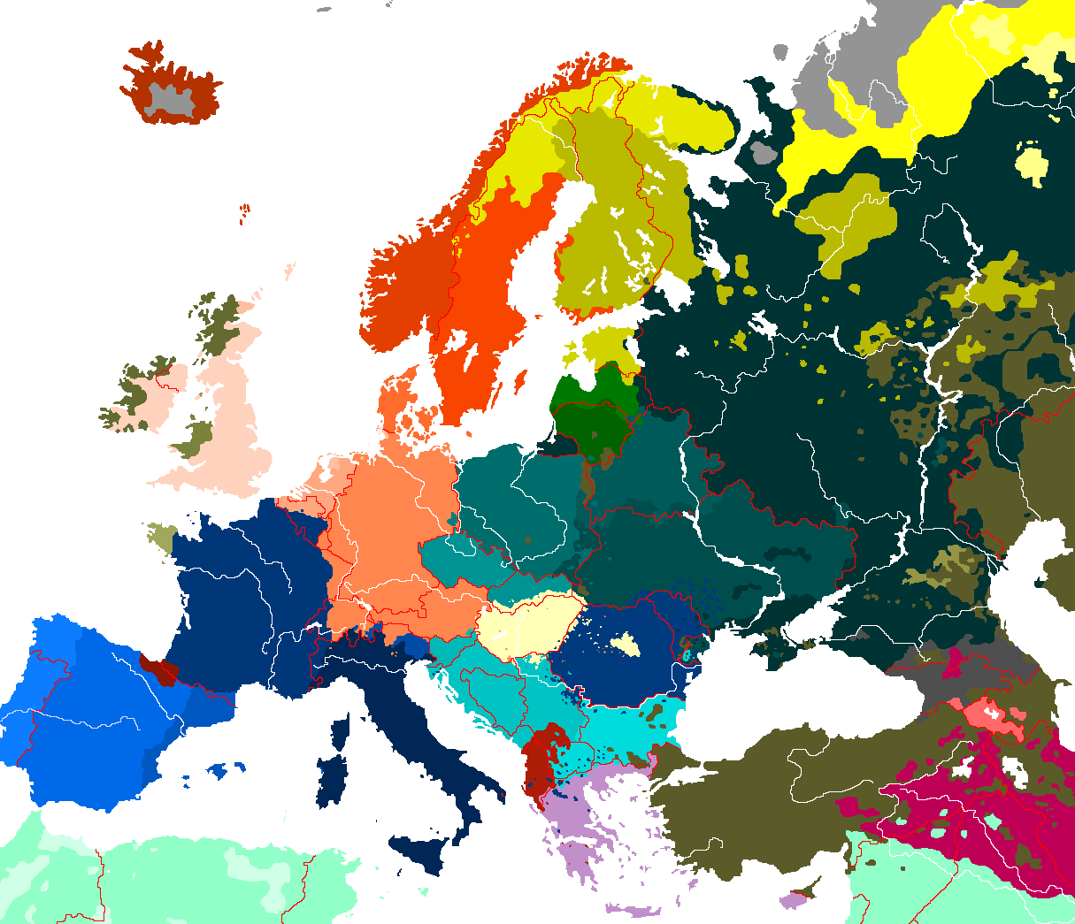
[Found on Wikipedia, author unknown]

Slide 55
[Found on Wikipedia, author unknown]
Encoding?
Population density?
Secondary languages?
Rivers?
No data source

Slide 56
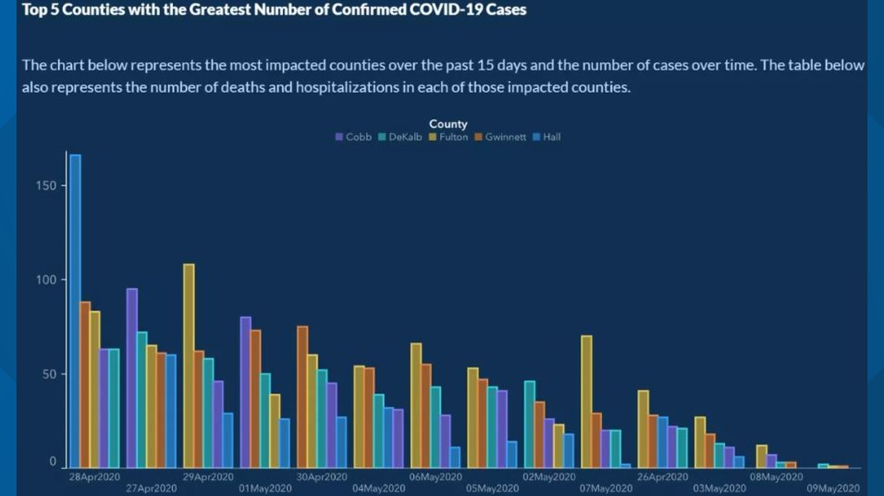
[Georgia Department of Public Health]

Slide 57
[Georgia Department of Public Health]
I CAN’T EVEN…

Slide 58
TAKE-AWAYS
Effective data visualizations provide insights and facilitate understanding.
The basic principles can guide your visualization design and consumption.
Be creative, but keep your data and your representations honest.
Be mindful of attempts to distort trends and conclusions with flashy visuals.
Data and code should be made available along with the displays.

